Slide 1
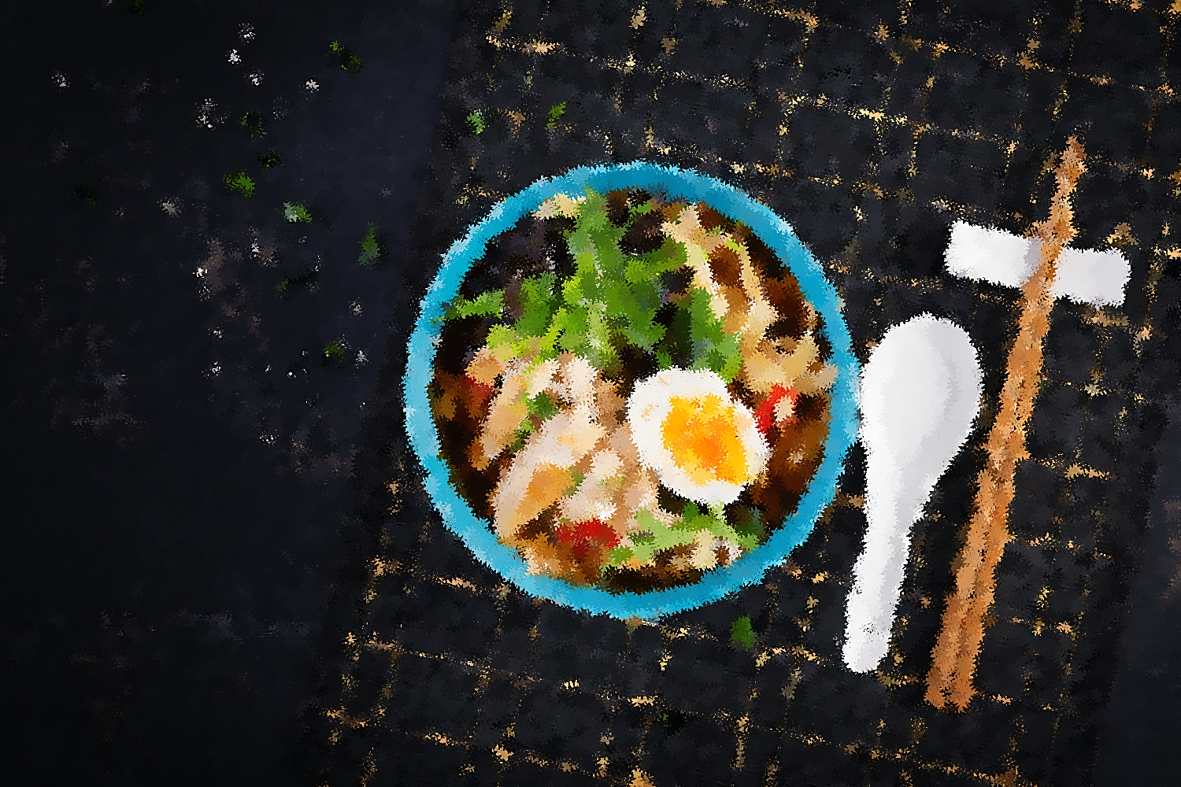
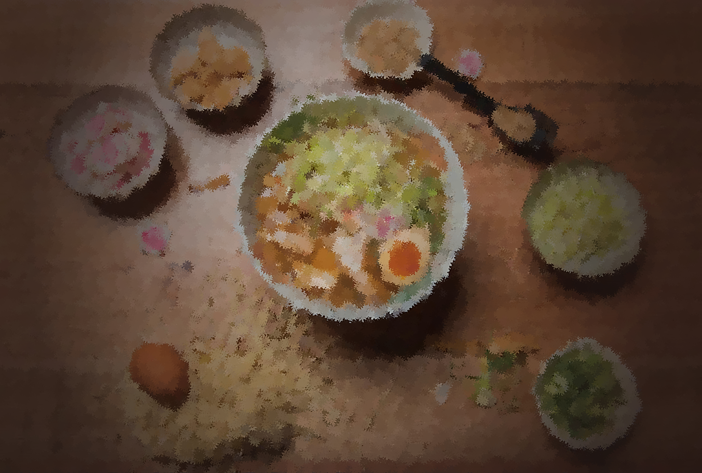
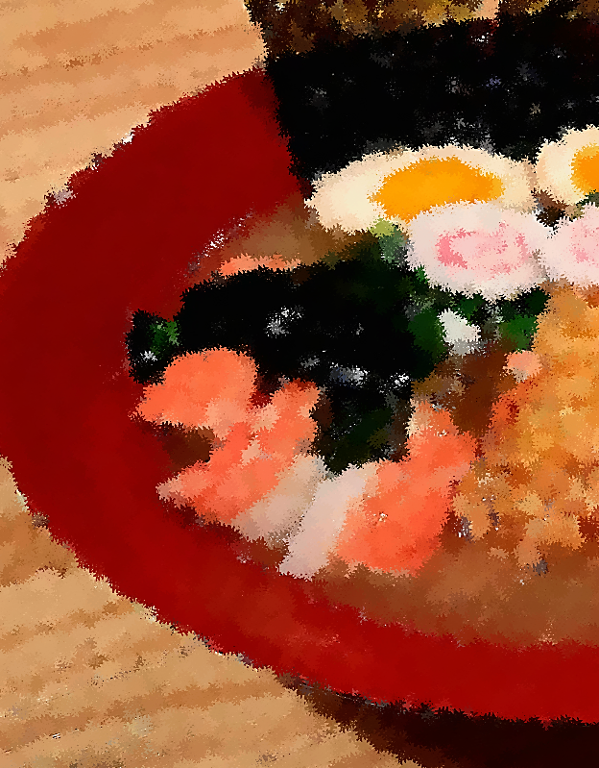
Restaurant Order Analysis
Analyze order data to identify the most and least popular menu items and types of cuisine
Notes:
NOTE: To replace a picture, just select and delete it. Then use the Insert Picture icon to replace it with one of your own!

Slide 2
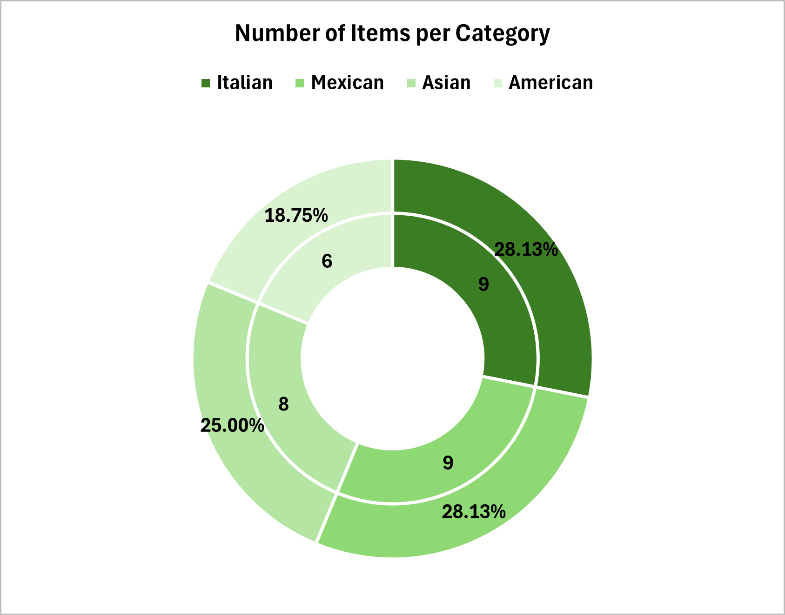
Explore the items table Analysis Recommendation
Menu Enhancement American dishes do not have that much items, and the Italian price is so much higher than other food
Do a customer survey about the dishes and prices of foods and ask what do they recommend about it.
Diversify American Dishes
Add more American comfort food options, such as BBQ ribs, sliders, or mac and cheese, to appeal to a broader audience.
Highlight American dishes with combo meal deals or promotional discounts to increase visibility.
Balance Pricing Across Categories
Evaluate customer sensitivity to Italian dish pricing. Consider introducing smaller portion sizes or budget-friendly Italian options to attract more customers.
Introduce Seasonal Specials
Create a rotating menu of seasonal dishes, incorporating customer-favorite categories like Italian and Asian.

Slide 3
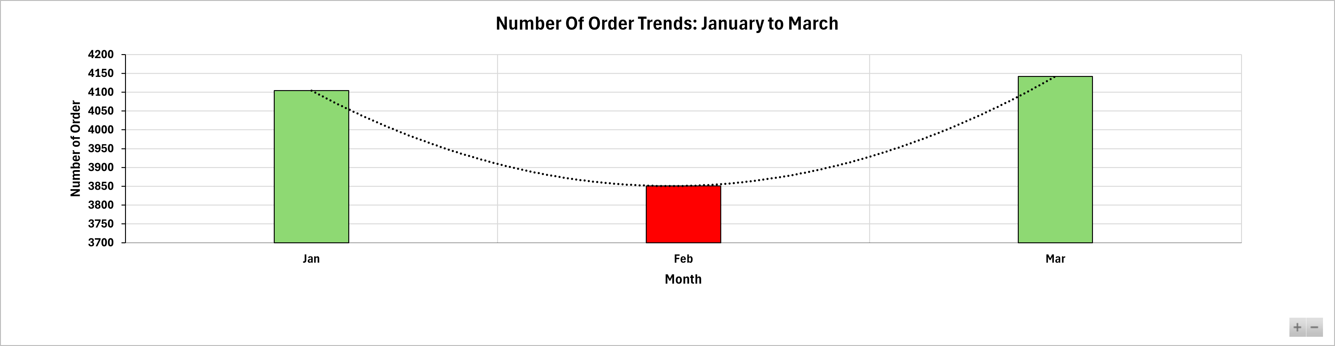
Explore the orders table Analysis
Recommendation
February, Number of orders 3851, Revenue 50790.35 has the lowest number of orders resulting to lowest revenue in January to March
Factors
Many reasons Inflation surge because of pandemic, high inflation, consumer spending has weakened because household spending power has taken a hit from rising prices.
Customers is buying more chocolate, flowers, and gifts because of February Month of heart introduce and discount introduce Valentine-themed promotions in February to counter low spending due to external factor
Sales and Marketing Strategies
Promotions for Low-Performing Months
February revenue was the lowest. Counter this with Valentine-themed discounts, meal packages for couples, or “dine and win” promotions.
Utilize loyalty programs with points or discounts for repeat orders during slower months.
Highlight Popular Dishes
Promote top-performing items like Hamburger and Italian dishes through social media and in-store displays.
Offer limited-time bundles featuring these dishes to boost sales.
Upselling and Cross-Selling
Train staff to recommend complementary items for every order (e.g., drinks, desserts, or appetizers).
Implement digital recommendations for online orders based on popular pairings.

Slide 4
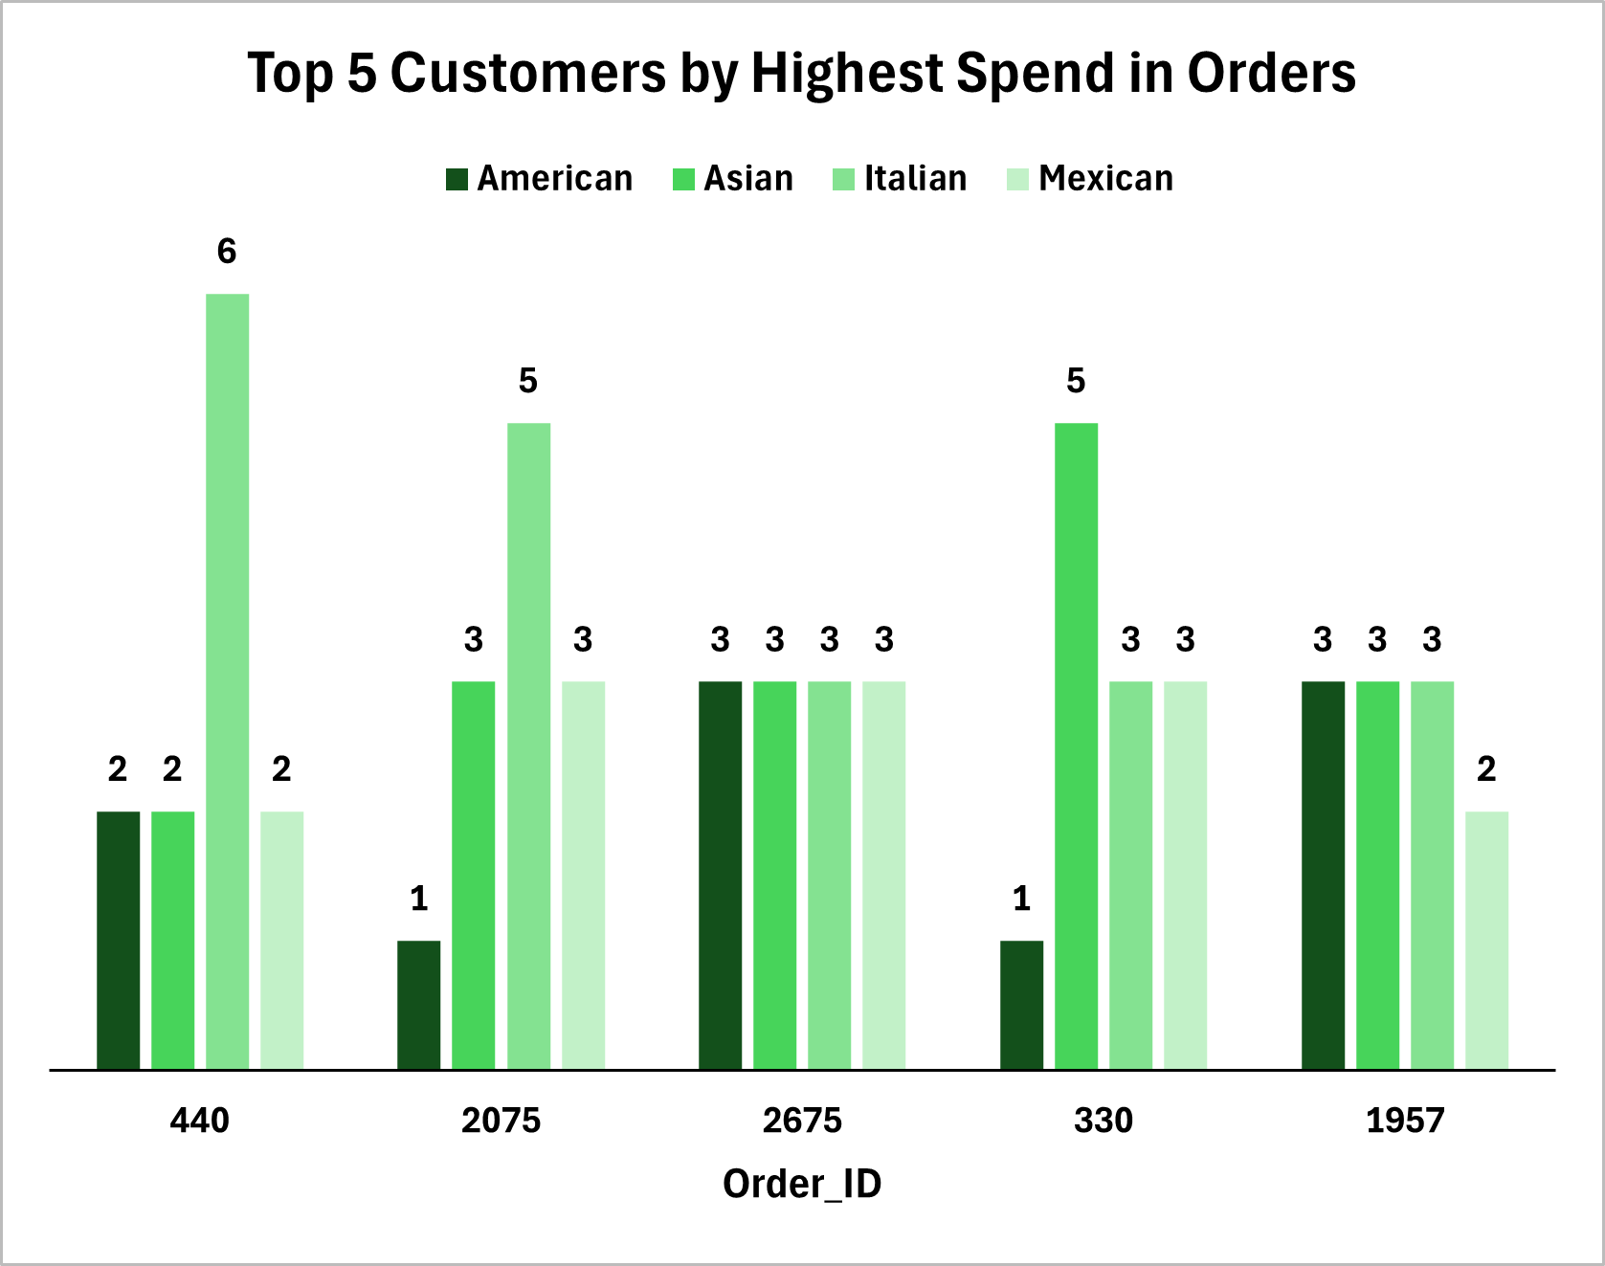
Analyze customer behavior Analysis Recommendation
Customer Engagement
Focus on High-Performing Categories: Collect qualitative feedback on menu items like Chicken Tacos or Italian food to understand specific issues why they perform better and replicate those strategies across other categories.
Gather Feedback
Use surveys or feedback forms to understand why certain items are less popular (e.g., Chicken Tacos). Adjust recipes, presentation, or pricing accordingly.
Personalize Customer Experience
Use loyalty programs to collect data on customer preferences and offer personalized deals or recommendations.

